Slide 1


Slide 2

Migrate Between Office 365 tenants

Slide 3

Peter Schmidt
Cloud Architect
MVP: Office Apps & Services
MCM: Exchange, MCSM: Exchange, MCT
Blog: www.msdigest.net
Twitter: @petsch
Mail: peter@neoconsulting.dk

Slide 4

Agenda
Intro
Scenarios
Migration
Lessons Learned

Slide 5

Business Drivers
Mergers
Acquisitions
Divestitures
Notes:
Why – requirement from the Business
Fusion eller opkøb
Ved opkøb, kan det også være et split eller carve-out af en del af virksomheden
LGN:
Vil nok skrive ‘Divestitures’ istedet for ‘Splits’ – det er den korrekte betegnelse for frasalg
Der mangler et c i Acquisitions

Slide 6
The Migration Journey!
Remember all the stakeholders in the entire Organization
The migration journey contains:
Assessment
Planning and testing
Migration
End User Adoption
To succeed you need the business with you!
End User communitation and planning is VERY important
Notes:
Microsoft 365 tenant to tenant migration is one of the most complicated tasks that most businesses often need to execute at the time of mergers and acquisitions. But, if the admins get proper training, then they can efficiently perform the migration.
LGN: “Information protection journey”? Her har du vist kopieret fra et andet slidedeck ..

Slide 7

The Planning Process
Discovery
1
Planning
2
Design
3
Initial Test
4
Migration
5
Post Migration
7
Hypercare
6
Notes:
Discovery / Assessment of source tenant
New Tenant Configuration / Licences / users etc.
Design and configuration
Initial Test / Pilot Migration
Post Migration / End User Hypercare
Your Office 365 Migration Plan in Five Simple Steps (avepoint.com)

Slide 8
What to do?
Assessment
Know your data and your users
Notes:
LGN: Vigtige pointer
Ejerskab af processen internt i organisationen
Kendskab til organisationen og det miljø der skal migreres
Hvem er hvem
Hvad bruges mailbox / Team / distributionsliste xyz til ?

Slide 9
Identify the workloads to be migrated
Azure Active Directory
Exchange Online
OneDrive for Business
SharePoint Online
Teams
Notes:
Office 365 Tenant to Tenant Migration - a Complete Survival Guide - ppt download (slideplayer.com)
Azure Active Directory
Users and Grouops
Exchange Online
Mailboxes
Contacts
Calendars
Archives
Shared Mailboxes
Rooms
Distribution Lists
Public Folders
OneDrive for Business
SharePoint Online
Sites
Teams
1-1 Chats
Group Chats
Files (sites)

Slide 10

What about other services/workloads
Yammer
Microsoft Information Protection
Intune
Planner
Stream
PowerBI
PowerApps
PowerAutomate

Slide 11
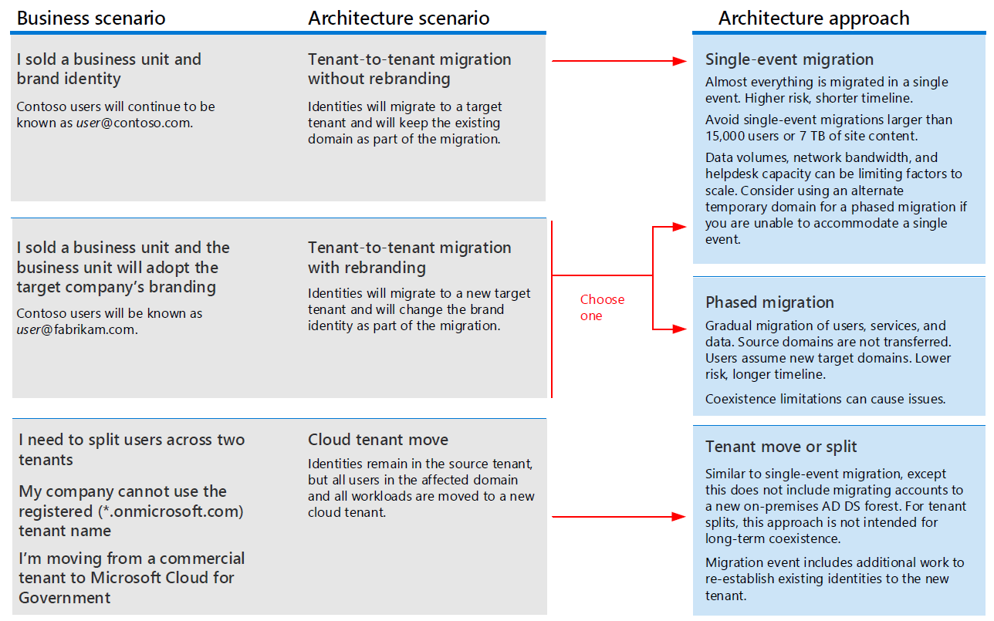
Migration Scenarios
Notes:
Move into existing tenant
Move to new AD and tenant

Slide 12
Migration Approach
Big Bang
Sequential
Notes:
Big Bang – small business (also known as cut-over)
Less complex – over a weekend
Sequential in larger organizations
Can be highly complex
Depending on how long the migration run
Depending on co-existence during the process

Slide 13
Big Bang
Advantages
Less complex
Easier end-user training and understanding
Minimal transistion
Disadvantages
Limited scenarios
Higher Risk
Availability

Slide 14
Sequential
Advantages
Less risks
No alternatives in large environments
Disadvantages
More complex
More difficult process
Time consuming
Co-existence

Slide 15
Important Decisions
Move into:
New environment
Existing environment
Migration Approach:
Big bang migrations
Staged Cut-over
Co-Existence
Balance the Risk and Business Deadlines
Notes:
LGN:
Big bang migrations er reelt kun et alternativ ved mindre installationer hvor du kan lave cutover hen over en weekend.

Slide 16

Migration of the services

Slide 17


Identity
Creating Users in the new tenant and environment
Cloud-Only
Active Directory
Federated
Notes:
LGN:
Værd at pege på at tenant -> tenant migrering ofte vil hænge sammen med AD migrering ?

Slide 18

Exchange Migration
Mailboxes
Shared Mailboxes
Rooms and Equipment
Groups
Meetings
Mailbox Permissions and Delegations
Public Folders
Notes:
LGN:
- Beslut tidligt i processen hvordan shared mailboxes etc. skal håndteres

Slide 19
E-mail planning
E-mail Domain
Co-existence
Mail flow
Calendar federation
MX Backup
Notes:
LGN:
kompleksitet omkring flytning af domæner mellem tenants
udfordringer ved long-term coexistence

Slide 20
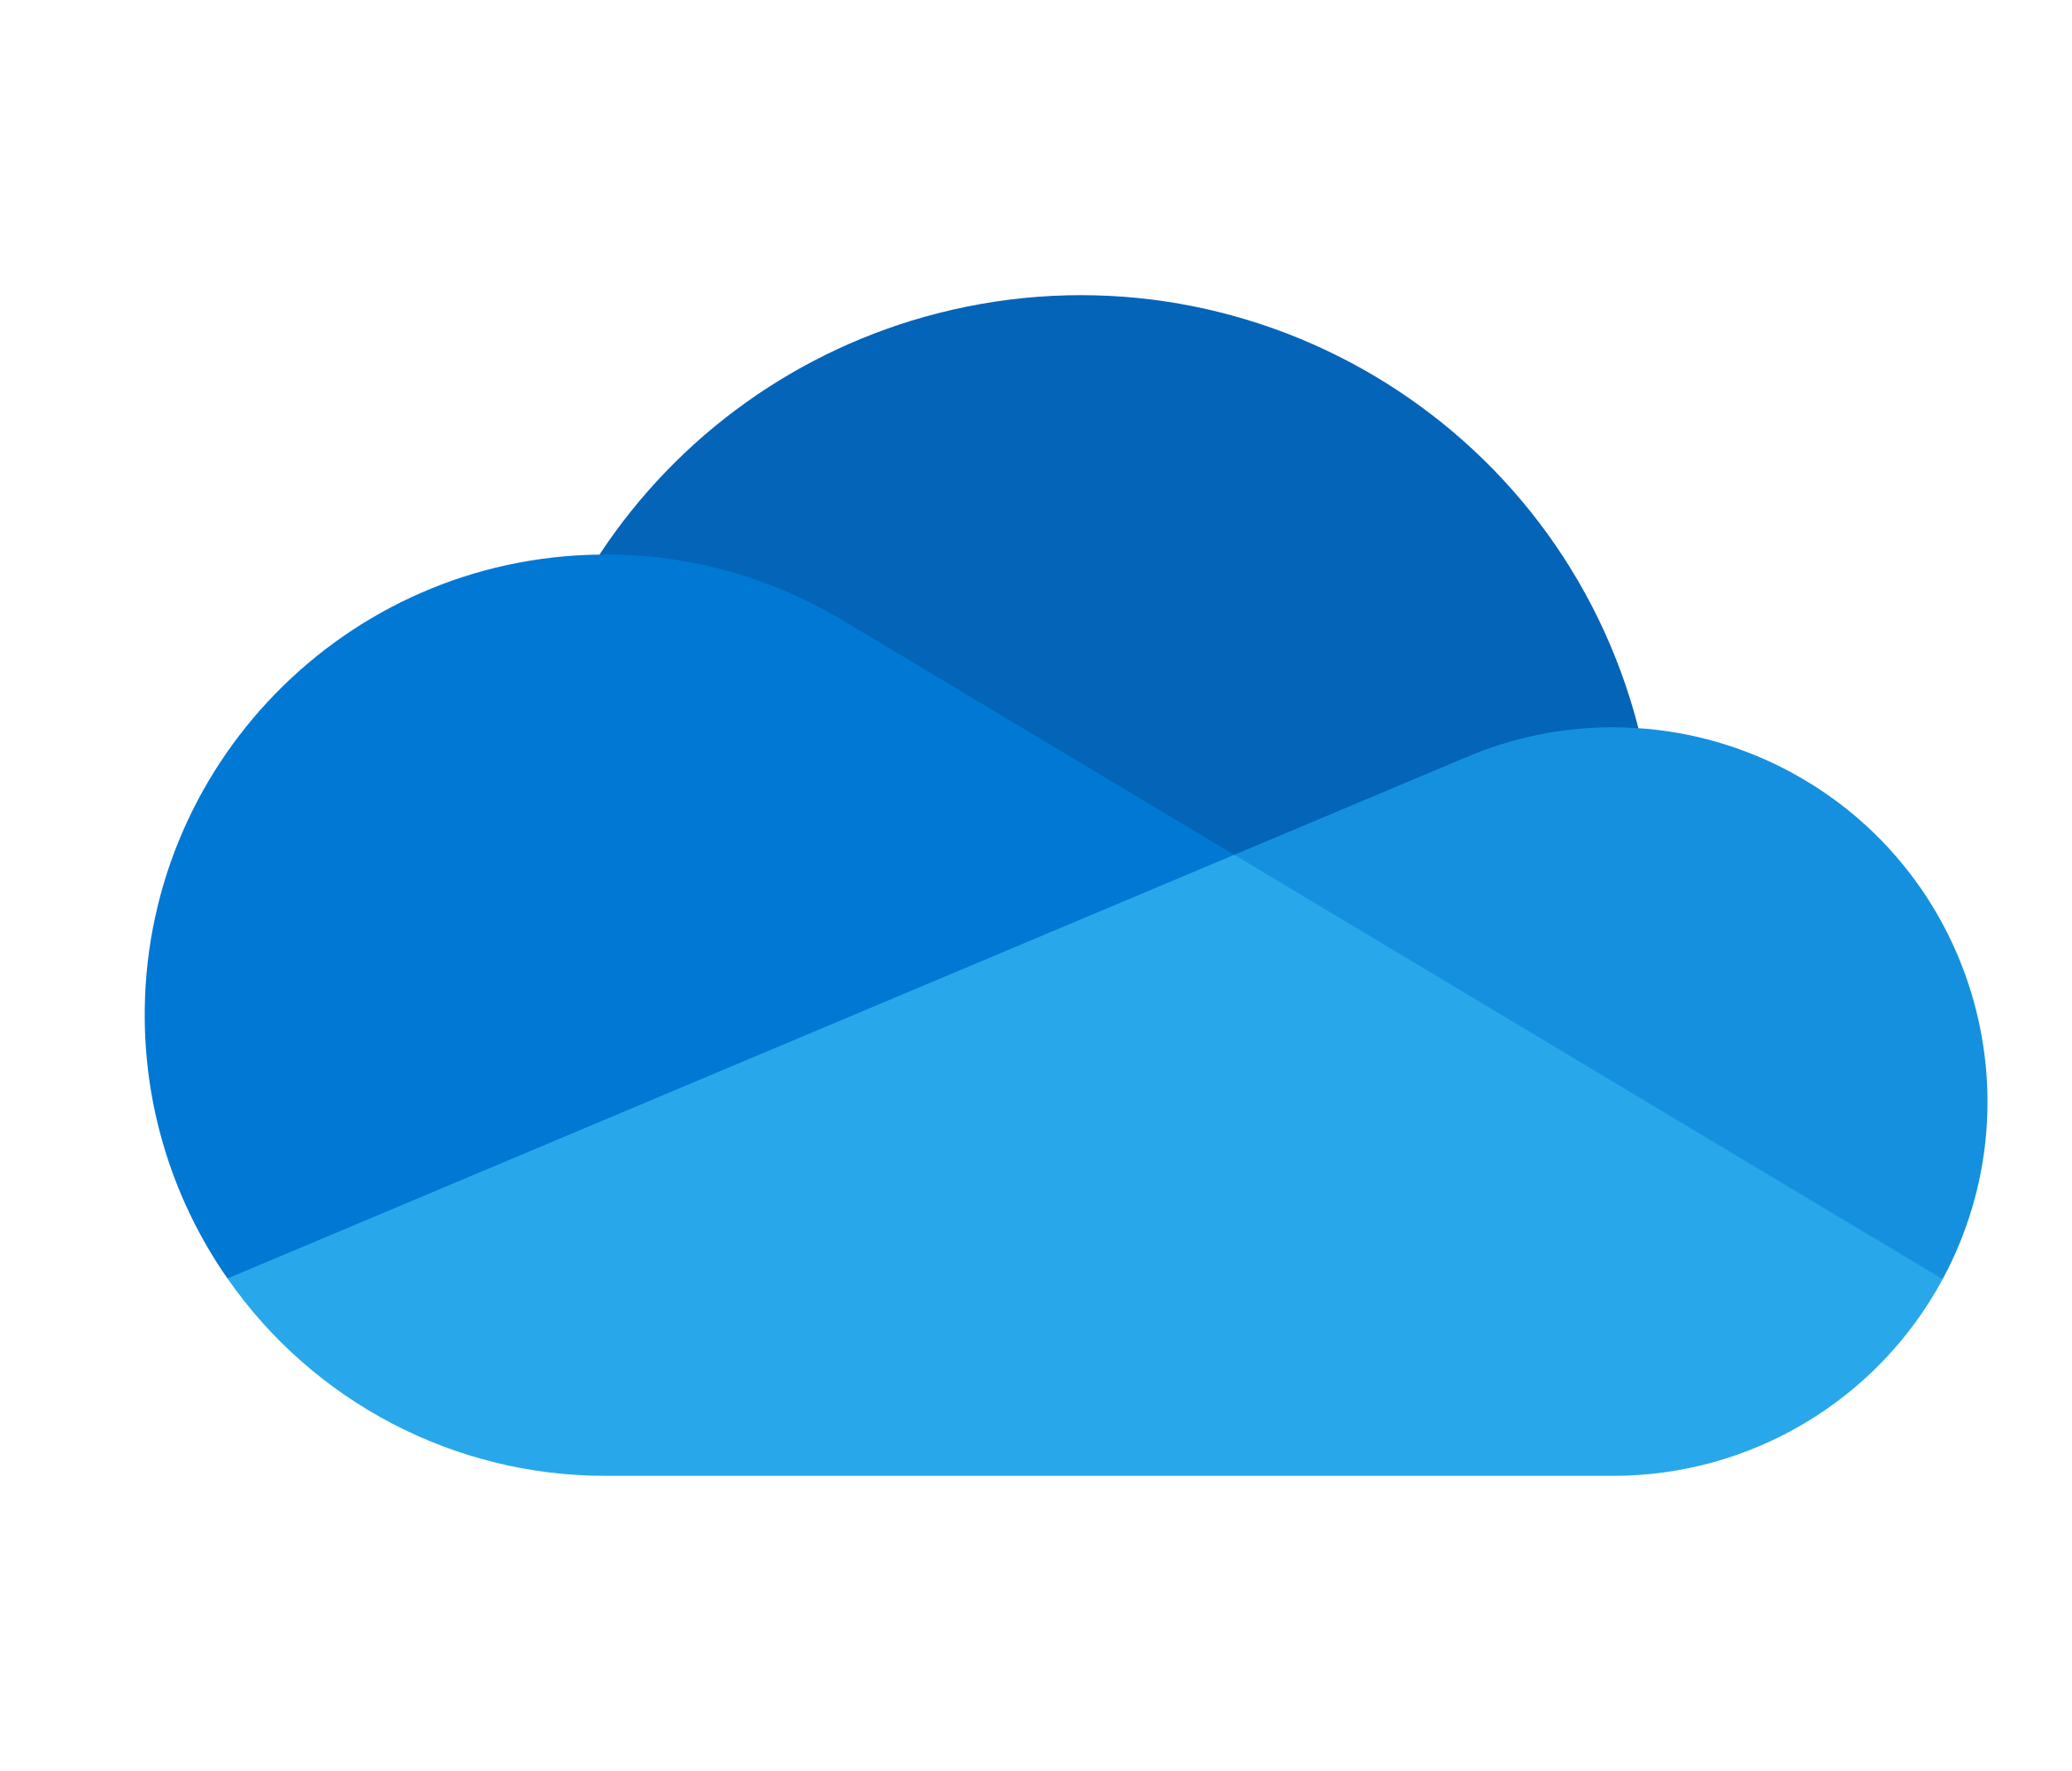

SharePoint & OneDrive
Data
Issues with:
Custom settings

Slide 21

Microsoft Teams
What can be migrated:
Teams data (files)
“Teams chat”
Team chat
1-1 chat
Limited APIs
Different data storage sources
Recreate Structure and permissions

Slide 22

Migration Challenges
Meetings
Existing meetings need to be deleted by users – cannot be rescheduled
New meetings will need to be re-created by all users, replacing existing meetings
Shared Links
SPO Custom sites
External Guests
Azure AD App Registrations and 3rd Party Apps
Migration Performance
Bandwidth Throttling

Slide 23

Users Are the Key to Succes
End User Communication
Communicate the Plan
When will they be migrated
How will it affect them
What tasks might be required by them after migration
Clients and Mobile Phones
Software reconfiguration
Profile recreation
Communication
Method
Objective and Purpose
Frequency
Responsibility
Support

Slide 24

Post Migration
Old Tenant Cleanup
Client Cleanup
Licensing review
Notes:
Do not underestimate this…

Slide 25

Some of the Migration Tools Available
Quest On Demand Migration
BitTitan MigrationWiz
Skykick
CodeTwo
Microsoft’s own tools
Mover.io (through MS Support)
Cross Tenant Mailbox Migration (Public Preview)
Notes:
To name some of the tools available for tenant to tenant migrations
LGN: Måske lidt pros / cons for de enkelte ?
https://docs.microsoft.com/en-us/exchange/mailbox-migration/migrate-mailboxes-across-tenants

Slide 26

Migrations Warning signs
No Sponsor
No Data Assessment
No Risk Assessment
No User Engagement
No Strategy
No Migration experience
No Tools
But you still set a timeline…

Slide 27
Lessons Learned
Content overview
Plan is the key to success
End User Adoption and Communication is the key to success
Testing is essential
Execute
Organizational Stakeholders
Migration is complex
Notes:
LGN: Lessons

Slide 28
Evaluering: https://forms.office.com/r/Tsqs7AKrKY

